Slide 1







Age and gender
Detection
Presented by: Basmala Salama

Slide 2



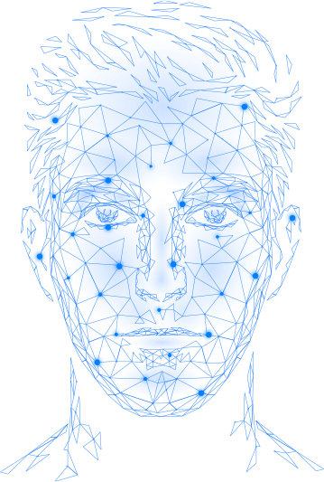


Introduction
Facial age and gender prediction have garnered significant attention in recent years due to their wide-ranging applications, including personalized user experiences, content recommendation, and demographic analysis. This project explores into the field of computer vision In order to process these tasks using Convolutional Neural Networks (CNNs). The dataset of choice is the UTKFace dataset, a large collection of titled face photos covering a wide age range.

Slide 3
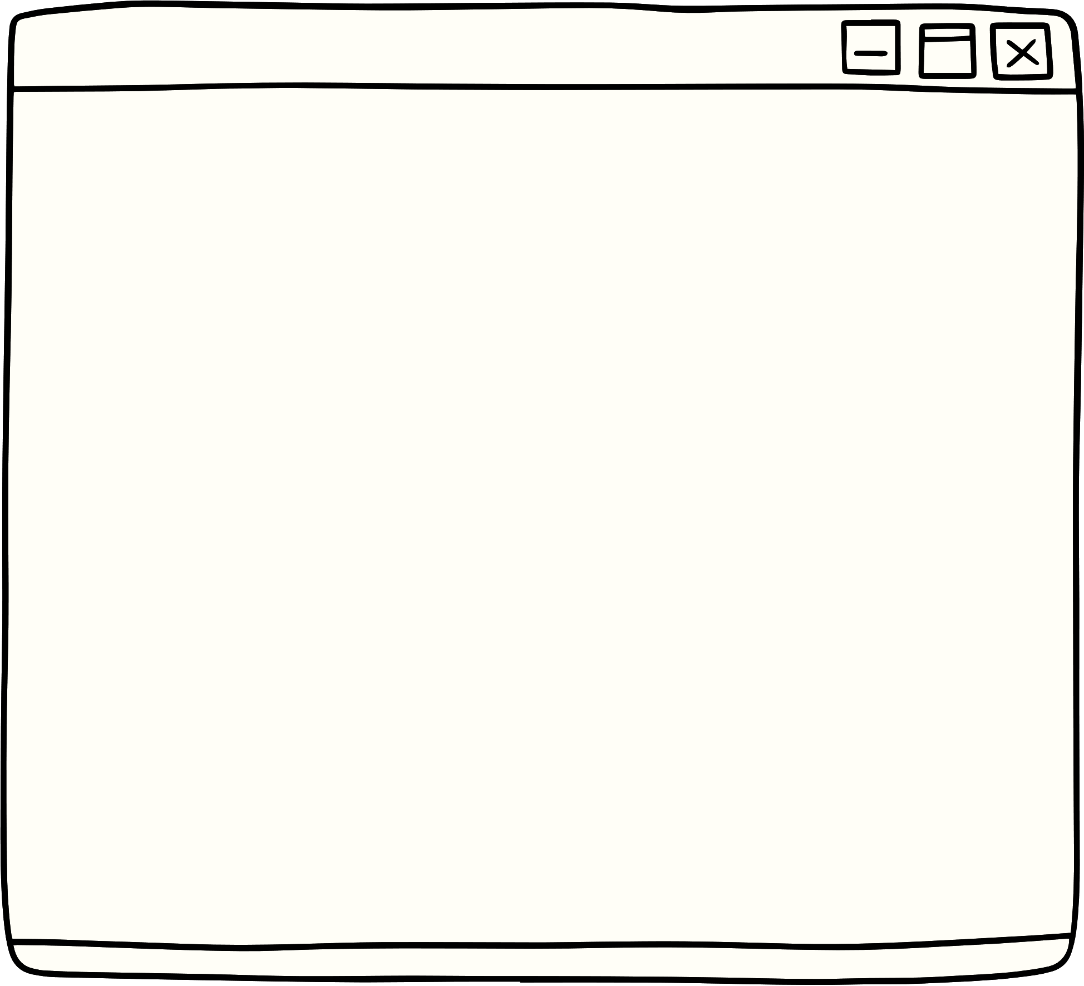
Problem Statement
The accurate prediction of age and gender from facial images is not only a challenging computer vision problem but also a valuable tool in many domains.
This project aims to develop a CNN-based model capable of predicting age and gender from facial images with high accuracy.
Accurate predictions are important for many applications such as targeted advertising, content personalization, and age-verified access control systems.

Slide 4


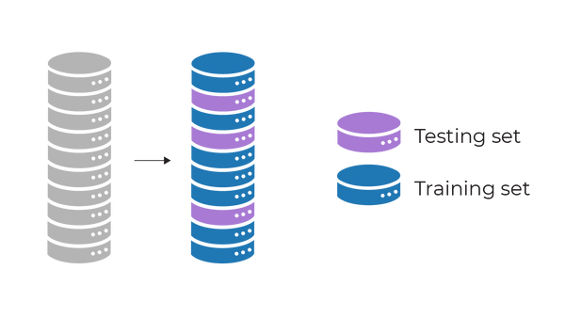


Previous Work
Several research studies have explored various techniques and models in the domain of age and gender prediction, providing valuable insights and methodologies.
According to the previous work using the UTKFace dataset what makes this project different is the approach taken to enhance accuracy.
Rather than predicting a precise age, which is challenging even for humans, I divided the age labels into categories, simplifying the prediction task and achieving higher accuracy.
Additionally, while many projects do not split their data into separate training and testing sets, I choose this division, recognizing its advantages in model evaluation.
This approach ensures a more accurate model, which improves the quality of age and gender predictions.

Slide 5






Objectives
Design and Implement CNN Model:
Create a CNN model that can predict age and gender from facial photos.
Evaluate Model Performance:
Assess the model's performance using evaluation metrics, including accuracy and mean absolute error (MAE).
Model Predictions:
Showcase the model's capabilities by making predictions on sample photos.

Slide 6

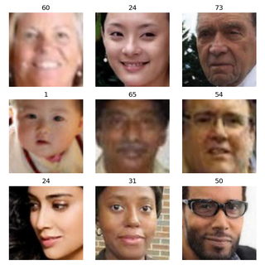

Dataset Description
A dataset size exceeding 20,000 facial images.
Age annotations ranging from 0 to 116 years.
Labels for age, gender, and ethnicity.
Variability in facial expressions, lighting conditions, and poses.
The dataset's diversity makes it suitable for training and testing our model.
The UTKFace dataset is the project's foundation, providing an extensive collection of facial photos for analysis. Key attributes of the dataset include:
Dataset Link

Slide 7


1
Load the dataset
Exploratory Data Analysis
2
Data Preprocessing
Methodology
3
Train Test Split
Chosen methodology revolves around Convolutional Neural Networks (CNNs).
4
Building and Training the CNN model
5
Test and Evaluation

Slide 8
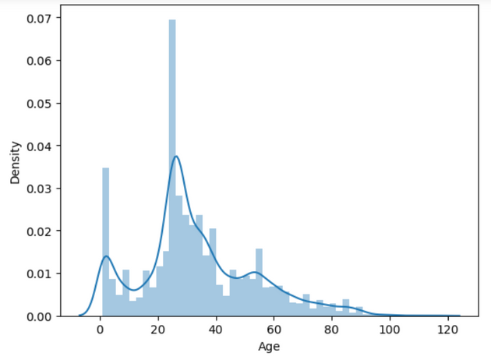
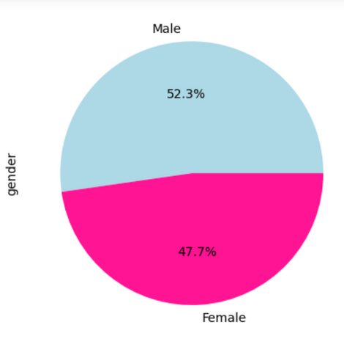
Data Exploration
Exploring the dataset was very important for gaining insights and understanding its characteristics. During data exploration, I visualized the age and gender distribution within the dataset. I also identified certain challenges, such as image quality and variations in facial expressions.

Slide 9
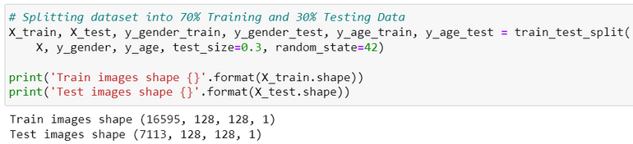
Experimental Setup
Data Preprocessing
Grayscale Conversion: Converting color images to grayscale simplifies the algorithm.
Standardized Resizing: All images were resized to a fixed size to ensure uniformity in the dataset.
Numpy Array Conversion: Because neural networks can handle only numpy arrays and to optimize memory usage.
Data Normalization: Data normalization was applied to standardize the distribution of pixel values.
Train Test Split
I divided the dataset into a training set (70%) and a testing set (30%)

Slide 10
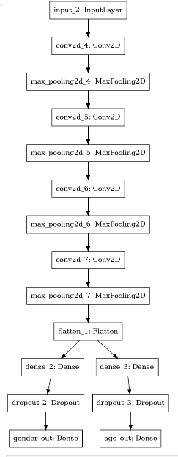
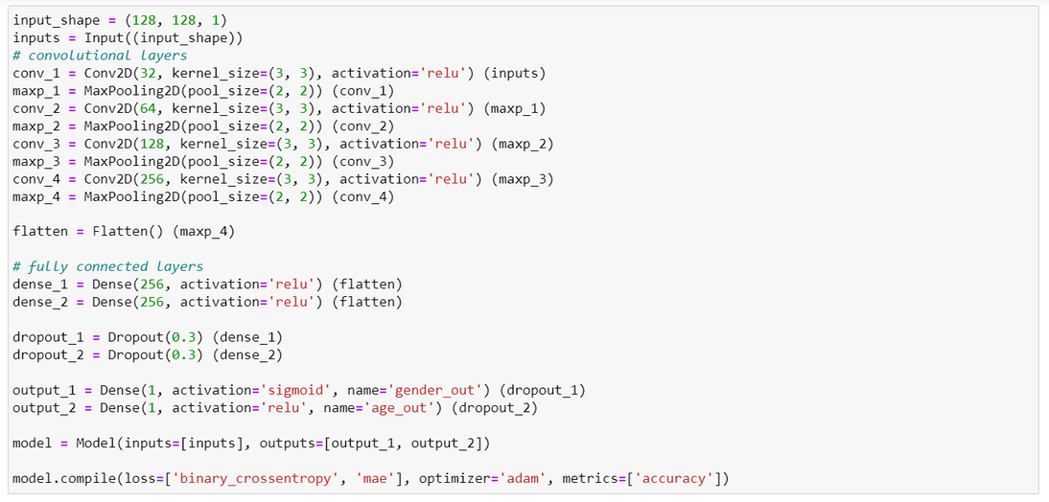
The CNN Model
The CNN model is designed to extract meaningful features from facial images, making it well-suited for the task.
The model architecture consists of convolutional layers followed by max-pooling layers, leading to fully connected layers for prediction.

Slide 11
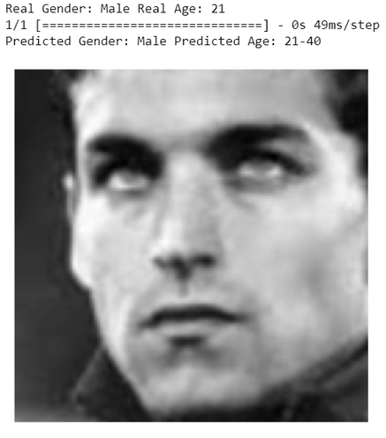
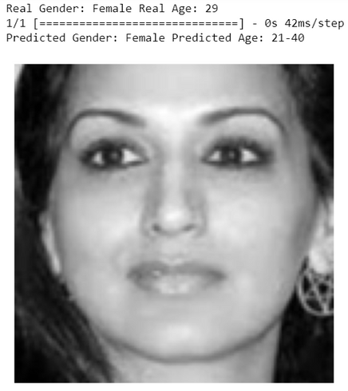
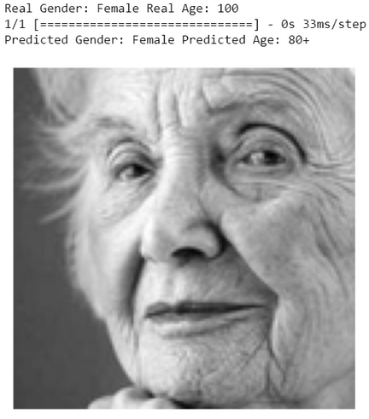

Results
The model achieved high accuracy:
Accurate Model Predictions:

Slide 12

Conclusion
In conclusion, this project successfully developed a facial age and gender prediction model using a CNN and the UTKFace dataset. While achieving promising results, but I can make it even better in the future by using more kinds of pictures and making it work in real-time with live images or videos. This would be useful in many fields, such as security systems or personalized user experiences.

Slide 13

Thank you

